Slide 1
Spring Expression Language Dependency Injection
The Spring EL is similar with OGNL and JSF EL
The Spring EL evaluated or executed during the bean creation time.
In addition, all Spring expressions are available via XML or annotation.
OGNL stands for Object-Graph Navigation Language; it is an expression language for getting and setting properties of Java objects,
plus other extras such as list projection and selection and lambda expressions

Slide 2
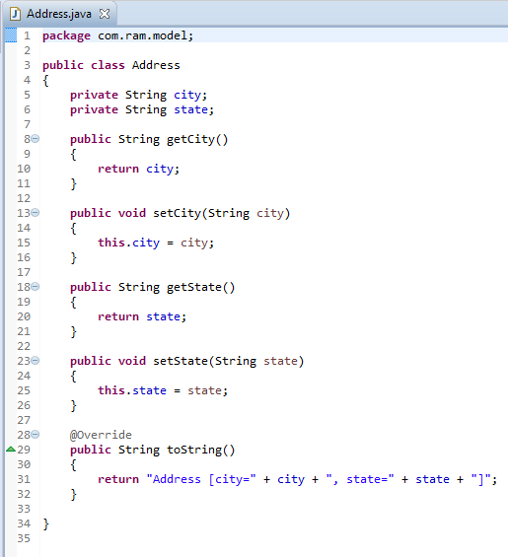
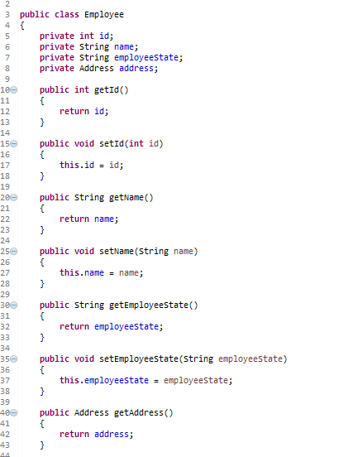
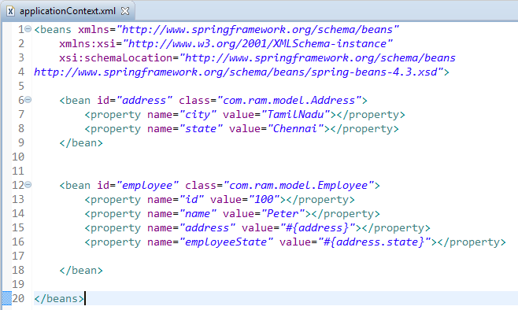
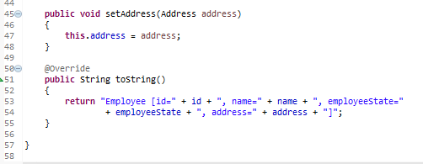
Spring Expression Language Dependency Injection
The SpEL are enclosed with #{ SpEL expression }, see following example in XML bean definition file.
#{address} – inject “addressBean” into “employeeBean” bean’s “address” property.
#{address.state} - inject “addressBean”‘s “state” property into “employeeBean” bean’s “employeeState” property.
Wrong city change

Slide 3
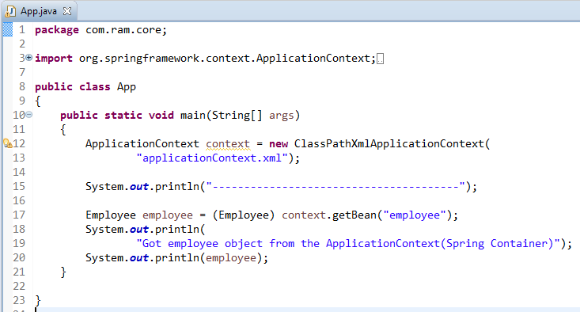
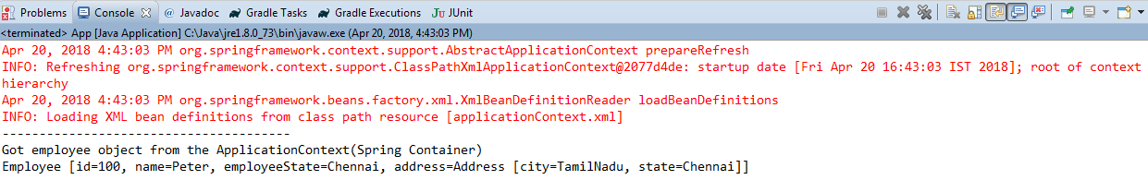
Spring Expression Language Dependency Injection

